Slide 1
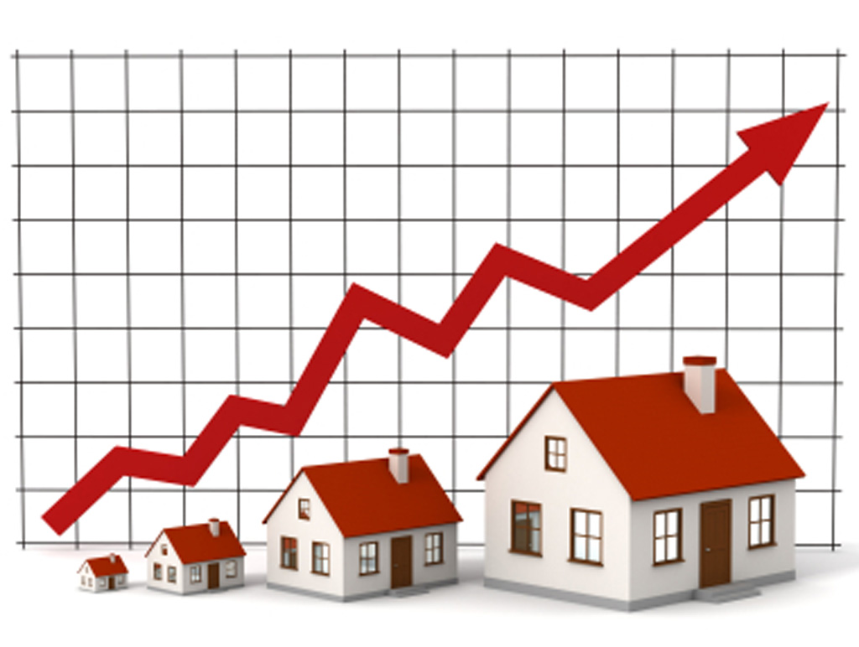
HOUSING PRICE PREDICTION PRESENTATION
By:
Pratiksha Potghan
Internship 30,
FlipRobo Technology

Slide 2
Agenda:
Introduction
Problem Statement
Objective
Exploratory Data Analysis (EDA)
Visualization
Conclusion

Slide 3
Introduction
Problem Statement:
Houses are one of the necessary need of each and every person around the globe and therefore housing and real estate market is one of the markets which is one of the major contributors in the world’s economy. It is a very large market and there are various companies working in the domain. Data science comes as a very important tool to solve problems in the domain to help the companies increase their overall revenue, profits, improving their marketing strategies and focusing on changing trends in house sales and purchases. Predictive modelling, Market mix modelling, recommendation systems are some of the machine learning techniques used for achieving the business goals for housing companies. Our problem is related to one such housing company. A US-based housing company named Surprise Housing has decided to enter the Australian market. The company uses data analytics to purchase houses at a price below their actual values and flip them at a higher price. For the same purpose, the company has collected a data set from the sale of houses in Australia.

Slide 4
The company is looking at prospective properties to buy houses to enter the market. You are required to build a model using Machine Learning in order to predict the actual value of the prospective properties and decide whether to invest in them or not. For this company wants to know:
1. Which variables are important to predict the price of variable?
2. How do these variables describe the price of the house?

Slide 5
Objective
Business Goal:
You are required to model the price of houses with the available independent variables. This model will then be used by the management to understand how exactly the prices vary with the variables. They can accordingly manipulate the strategy of the firm and concentrate on areas that will yield high returns. Further, the model will be a good way for the management to understand the pricing dynamics of a new market.

Slide 6
Exploratory Data Analysis (EDA)
We have 2 datasets , one is train dataset and another is test dataset.
Train dataset is our main dataset which has 1168 rows and 81 columns(i.e features)
Test dataset is our predict dataset which has 292 rows and 80 columns.
Our target variable is Column “SalePrice”.

Slide 7
81 Columns of Dataset
'Id', 'MSSubClass', 'MSZoning', 'LotFrontage', 'LotArea', 'Street', 'Alley', 'LotShape', 'LandContour', 'Utilities', 'LotConfig', 'LandSlope', 'Neighborhood', 'Condition1', 'Condition2', 'BldgType', 'HouseStyle', 'OverallQual', 'OverallCond', 'YearBuilt', 'YearRemodAdd', 'RoofStyle', 'RoofMatl', 'Exterior1st', 'Exterior2nd', 'MasVnrType', 'MasVnrArea', 'ExterQual', 'ExterCond', 'Foundation', 'BsmtQual', 'BsmtCond', 'BsmtExposure', 'BsmtFinType1', 'BsmtFinSF1', 'BsmtFinType2', 'BsmtFinSF2', 'BsmtUnfSF', 'TotalBsmtSF', 'Heating', 'HeatingQC', 'CentralAir', 'Electrical', '1stFlrSF', '2ndFlrSF', 'LowQualFinSF', 'GrLivArea', 'BsmtFullBath', 'BsmtHalfBath', 'FullBath', 'HalfBath', 'BedroomAbvGr', 'KitchenAbvGr', 'KitchenQual', 'TotRmsAbvGrd', 'Functional', 'Fireplaces', 'FireplaceQu', 'GarageType', 'GarageYrBlt', 'GarageFinish', 'GarageCars', 'GarageArea', 'GarageQual', 'GarageCond', 'PavedDrive', 'WoodDeckSF', 'OpenPorchSF', 'EnclosedPorch', '3SsnPorch', 'ScreenPorch', 'PoolArea', 'PoolQC', 'Fence', 'MiscFeature', 'MiscVal', 'MoSold', 'YrSold', 'SaleType', 'SaleCondition', 'SalePrice'

Slide 8
SalePrice :Target Variable
SalePrice is our target variable with continuous values in it. As this column has continuous values so we can say that this is a problem of Regression and we need to create Regression Models.
We also check main_data.info()
Main_data is our main train dataset and info tells us about the datatypes and non null values in each columns.

Slide 9
Datatypes in our dataset
Main_data.info() gave us information that our dataset is having 38 numerical datatype and 43 object i.e categorical datatype.
For seperating numerical and object datatypes we used below syntax:
object_datatype = []
for i in main_data.dtypes.index:
if main_data.dtypes[i] == 'object':
object_datatype.append(i)
print(f"Object Data Type Columns are: ", object_datatype)
numerical_datatype = []
for i in main_data.dtypes.index:
if main_data.dtypes[i] != 'object':
numerical_datatype.append(i)
print(f"Numerical Data Type Columns are: ", numerical_datatype)

Slide 10
Numerical and Object Datatype
Numerical Datatype
'Id', 'MSSubClass', 'LotFrontage', 'LotArea', 'OverallQual', 'OverallCond', 'YearBuilt', 'YearRemodAdd', 'MasVnrArea', 'BsmtFinSF1', 'BsmtFinSF2', 'BsmtUnfSF', 'TotalBsmtSF', '1stFlrSF', '2ndFlrSF', 'LowQualFinSF', 'GrLivArea', 'BsmtFullBath', 'BsmtHalfBath', 'FullBath', 'HalfBath', 'BedroomAbvGr', 'KitchenAbvGr', 'TotRmsAbvGrd', 'Fireplaces', 'GarageYrBlt', 'GarageCars', 'GarageArea', 'WoodDeckSF', 'OpenPorchSF', 'EnclosedPorch', '3SsnPorch', 'ScreenPorch', 'PoolArea', 'MiscVal', 'MoSold', 'YrSold', 'SalePrice'
Object Datatype
'MSZoning', 'Street', 'Alley', 'LotShape', 'LandContour', 'Utilities', 'LotConfig', 'LandSlope', 'Neighborhood', 'Condition1', 'Condition2', 'BldgType', 'HouseStyle', 'RoofStyle', 'RoofMatl', 'Exterior1st', 'Exterior2nd', 'MasVnrType', 'ExterQual', 'ExterCond', 'Foundation', 'BsmtQual', 'BsmtCond', 'BsmtExposure', 'BsmtFinType1', 'BsmtFinType2', 'Heating', 'HeatingQC', 'CentralAir', 'Electrical', 'KitchenQual', 'Functional', 'FireplaceQu', 'GarageType', 'GarageFinish', 'GarageQual', 'GarageCond', 'PavedDrive', 'PoolQC', 'Fence', 'MiscFeature', 'SaleType', 'SaleCondition'

Slide 11
Null Values
After seperating datatypes , I also checked unique values using main_data[‘SalePrice’].unique() and also checked the duplicate values using main_data.duplicated().
After this I checked the null values in the dataset using main_data.isnull().sum(). By this syntax I was not clear that how many columns had null values, so I used below sytax:
null_counts = main_data.isnull().sum()
null_counts[null_counts >0].sort_values(ascending=False)
The above mentioned syntax gave me null values of columns in descending order.
After checking the null values I also filled the missing values using mean,median & mode.

Slide 12
Null values of the columns in descending order.
PoolQC 1161
MiscFeature 1124
Alley 1091
Fence 931
FireplaceQu 551
LotFrontage 214
GarageType 64
GarageYrBlt 64
GarageFinish 64
GarageQual 64
GarageCond 64
BsmtExposure 31
BsmtFinType2 31
BsmtCond 30
BsmtFinType1 30
BsmtQual 30
MasVnrArea 7
MasVnrType 7

Slide 13
Statistical Description
By using main_data.describe() , I got all the values of dataset including count, minimum, standard deviation, 25%, 50%, 75%, maximum, mean.
After filling all the missing values I got count for all 81 columns as 1168, this means now there is no missing data in our dataset.

Slide 14
Encoding
We can see that categorical data is more as compared to numerical data, so we need to convert it by using Encoding Technique.
Here I used Ordinal Encoder to convert all the categorical data to numerical data i.e (0/1, YES/NO type)
I used below syntax to convert categorical data to numerical data:
from sklearn.preprocessing import OrdinalEncoder
enc = OrdinalEncoder()
for i in main_data.columns:
if main_data[i].dtypes=="object":
main_data[i]=enc.fit_transform(main_data[i].values.reshape(-1,1))

Slide 15
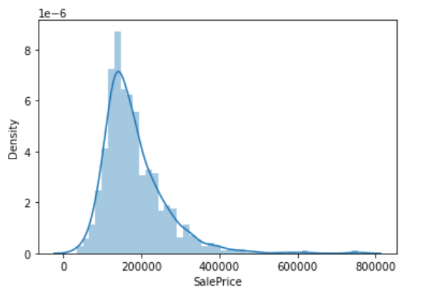
Visualization
Distribution plot for target variable.

Slide 16
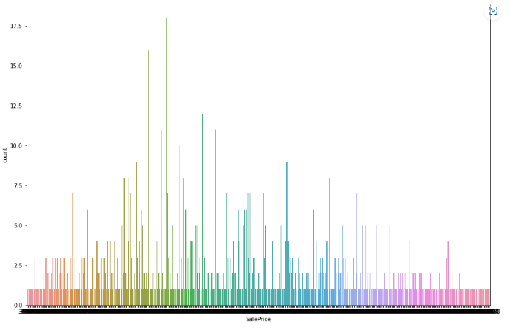
Countplot
Target Variable (SalePrice Counts)

Slide 17
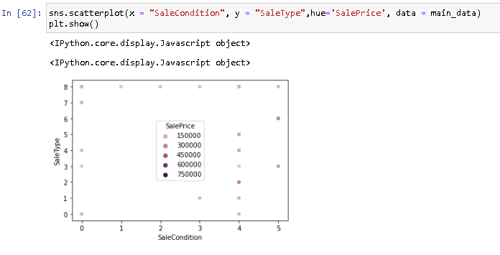
ScatterPlot

Slide 18
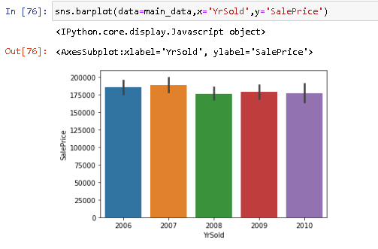
BarPlot

Slide 19
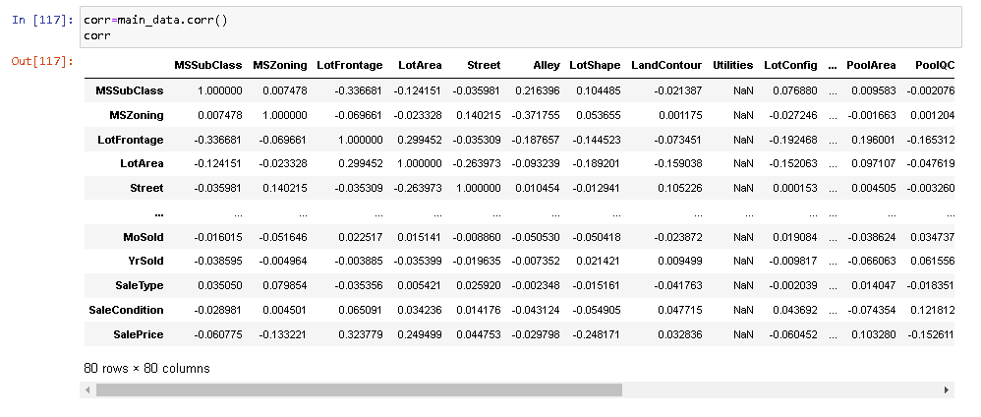
Correlation
A correlation matrix is simply a table which displays the correlation. The measure is best used in variables that demonstrate a linear relationship between each other. The fit of the data can be visually represented in a heatmap.

Slide 20
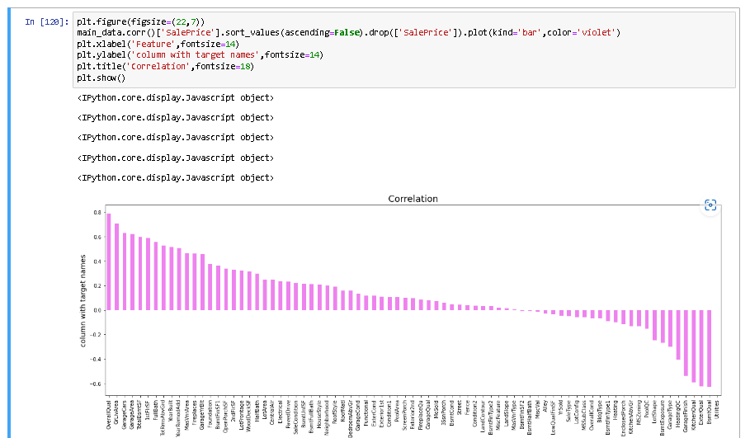
Correlation using Barplot

Slide 21
Outliers and Skewness
After checking correlation, I checked the outliers in 4 steps as there were many columns.
By using below function I was able to check the outliers present in the dataset.
main_data.iloc[:,0:20].boxplot(figsize=[25,10])
plt.subplots_adjust(bottom=0.25)
plt.show()
After checking outliers , I checked the skewness of the dataset using
Main_data.skew()
After checking the skewness, I splitted the indepedent and target variable in ‘x’ and ‘y’.

Slide 22
Model Building and Evaluation
Below are modeling approach made to build an model :
Linear
Random Forest
Decision Tree
XGBoost
k-nearest neighbors (KNN)

Slide 23
The Predict test and train values
Predict Test
Linear = 82.16
Random Forest = 89.3
Decision Tree = 79.17
XGBoost = 89.29
k-nearest neighbors = 81.9
Predict Train
Linear = 83.16
Random Forest = 97.9
Decision Tree = 100
XGBoost = 99.99
k-nearest neighbors = 81.04

Slide 24
Hyper Parameter Tuning
The Hyper parameter tuning is carried out for both Random Forest and XGBoost.
Because both has predict test value similar i.e. 89.
Hyper Parameter Tuning Performance
1.Random Forest Regressor :
R2 score - 87.30
CV score - 84.75
2. XGBoost Regressor :
R2 Score - 89.11
CV score -86.79

Slide 25
Best Model
We can say that GradientBoostingRegressor is our best model as it has better r2 score i.e 89.11 as compared to random forest regressor.
So we will consider XGBoost as our best model.

Slide 26
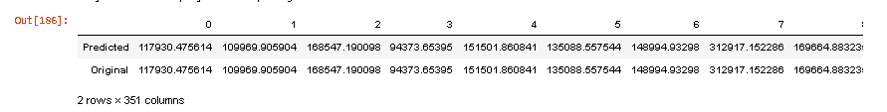
Conclusion
We built several regression models to predict the price of some houses given with some features. We evaluated and compared each model to determine the one with highest performance. We also looked at how some models rank the features according to their importance. In this paper, we followed the data science process starting with getting the data, then cleaning and pre-processing the data, followed by exploring the data and building models, then evaluating the results and communicating them with visualizations.
As a recommendation, we advise to use this model (or a version of it trained with more recent data) by people who want to buy a house in the area covered by the dataset to have an idea about the actual price. The model can be used also with datasets that covered areas provided that they contain the same features. We also suggest that people take into consideration the features that were deemed as most important as seen in the previous section; this might help them estimate the house price better.

Slide 27
THANK - YOU

